Slide 1


Slide 2
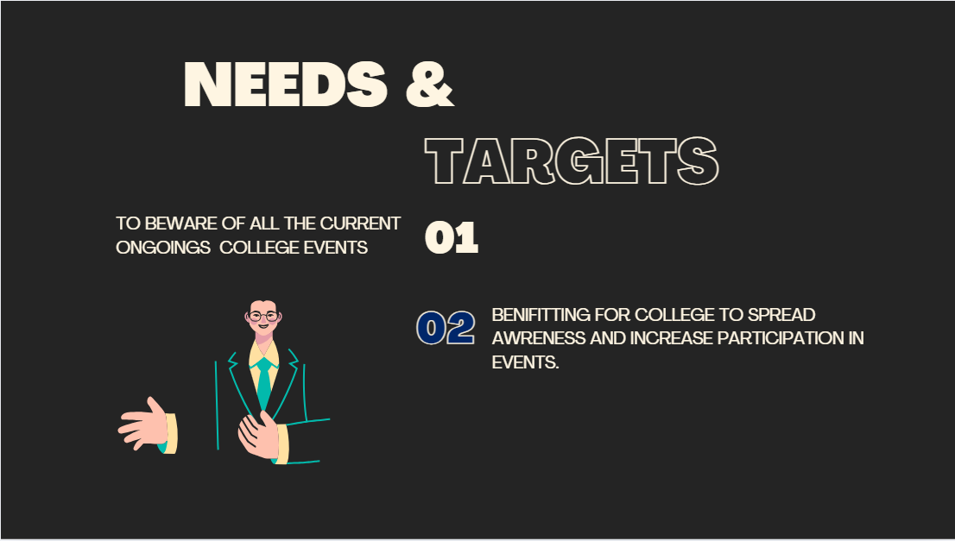

Slide 3
<!DOCTYPE html>
<html lang="en">
<head>
<meta charset="UTF-8">
<meta name="viewport" content="width=device-width, initial-scale=1.0">
<title>College News Portal</title>
<script src="https://cdn.tailwindcss.com"></script>
<style>
.hero-bg {
background-image: url('https://img.freepik.com/free-vector/hand-drawn-world-art-day-background_23-2149332778.jpg');
background-size: cover;
background-position: center;
}
.peacock-green {
background-color: #006F56; }
.peacock-green-text {
color: #006F56;
}

Slide 4
.dark-text {
color: #EAEAEA;
}
.light-text {
color: #111111; }
.silver-bg {
background-color: #E5E5E5; }
.about-bg {
background-image: url('https://www.kiet.edu/kiet/assets/frontend/img/about-location.jpg');
background-size: cover;
background-position: center;
background-attachment: fixed;
background-blur: 5px;
padding: 60px 0;
}
</style>

Slide 5
</head>
<body class="bg-gray-100 font-sans leading-normal tracking-normal">
<!-- Navigation Bar -->
<nav class="peacock-green p-4">
<div class="max-w-7xl mx-auto flex items-center justify-between">
<a href="#" class="text-white text-xl font-bold">College News</a>
<div class="space-x-6">
<a href="#" class="text-white">Home</a>
<a href="#news" class="text-white">News</a>
<a href="#about" class="text-white">About</a>
<a href="#contact" class="text-white">Contact</a>
</div>
</div>
</nav>

Slide 6
<section class="hero-bg text-white text-center py-20">
<h1 class="text-4xl font-bold">Welcome to the College News Portal</h1>
<p class="mt-4 text-xl">Stay updated with the latest news, events, and announcements.</p>
</section>
<section id="news" class="py-10">
<div class="max-w-7xl mx-auto px-4">
<h2 class="text-3xl font-semibold peacock-green-text mb-8">Latest News</h2>
<div class="grid sm:grid-cols-1 md:grid-cols-2 lg:grid-cols-3 gap-8">
<!-- News Card 1 -->
<div class="bg-white p-6 rounded-lg shadow-md">
<h3 class="text-2xl font-semibold text-peacock-green mb-4">UPCOMING HACKTHON</h3>
<p class="text-gray-700">THE COLLEGE TO HOST SMART INDIA HARDWARE HACKTHON.</p>
<a href="#" class="mt-4 inline-block text-peacock-green font-semibold">Read more &rarr;</a>
</div>
<div class="bg-white p-6 rounded-lg shadow-md">
<h3 class="text-2xl font-semibold text-peacock-green mb-4">New

Slide 7
<section id="contact" class="py-10 silver-bg">
<div class="max-w-7xl mx-auto px-4 text-center">
<h2 class="text-3xl font-semibold peacock-green-text mb-4">Contact Us</h2>
<p class="text-lg text-gray-700 mb-4">For any inquiries, feel free to reach out to us!</p>
<form class="space-y-4">
<input type="text" placeholder="Your Name" class="w-full p-3 rounded-lg border border-gray-300 focus:ring-2 focus:ring-peacock-green">
rounded-lg">Send Message</button>
</form>
</div>
</section>
<footer class="peacock-green text-white py-6">
<div class="text-center">
<p>&copy; 2024 KIET College News Portal. All rights reserved.</p>
</div>
</footer>
</body>
</html>

